Slide 1
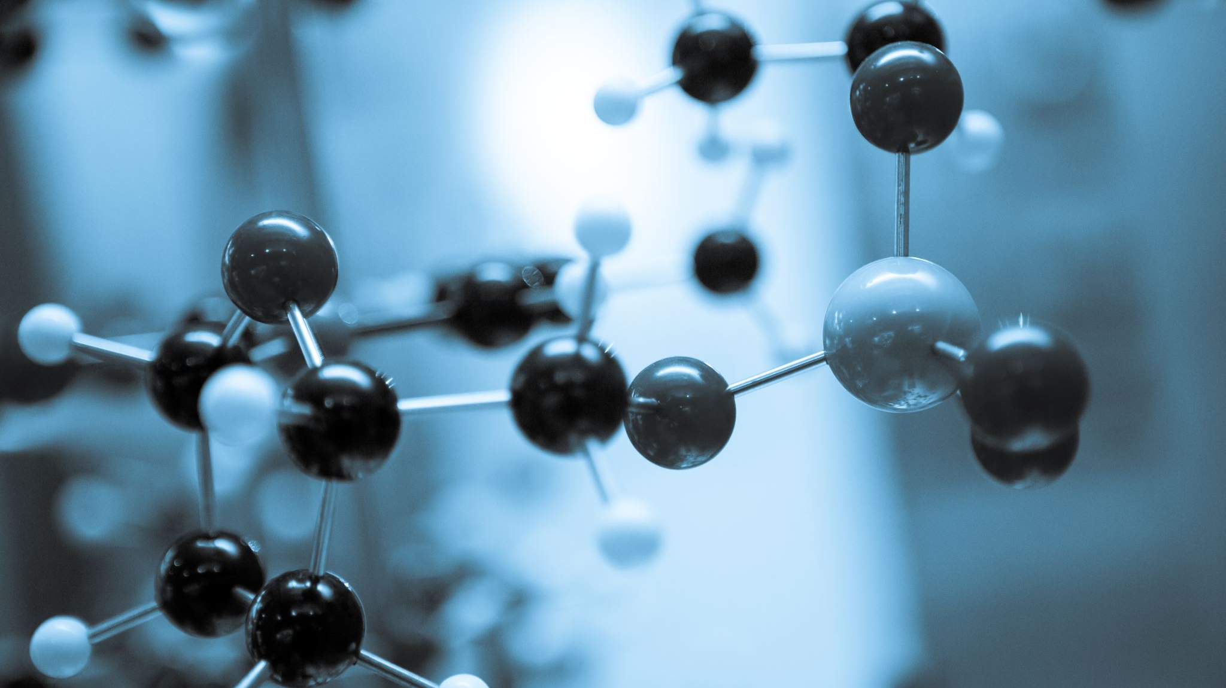
CS5720 Neural Networks & Deep Learning - Project(CRN: 23216) Title: Advanced Anomaly Detection

Slide 2
2.0 Group membrers Information
Team:
1. Divya Bokinala, 700726511
2. Harshitha Polsani (700732211)

Slide 3
3.0 Role/Responsibilities and Contribution in project
Responsibility:
(Implementation/methodology, Harshitha Polsani)
(Testing/critical assessment, Harshitha Polsani/ Divya Bokinala)
(Deployment/recommendations, Divya Bokinala)
Implementation/methodology: Implementation of the dataset with the model is in progress.
Testing/critical assessment: Testing the model if the model is giving accurate results still needs to be implemented.
Deployment/recommendations: Deploying the model and recommendations are yet to be concluded.

Slide 4
4.0 Motivation
There are several applications for image-to-image translation in computer vision, including style transfer, image colorization, and super-resolution. However, learning a mapping between two distinct visual domains with various features, such as differing textures, colors, shapes, and appearances, makes image-to-image translation a difficult challenge. When there is no matched data between the two domains—that is, no corresponding images across the two domains from which to learn—this process might become even more difficult. The term "unpaired image-to-image translation" refers to this issue.
Traditional image-to-image translation techniques, like pix2pix, develop the mapping between two domains using paired training data. But gathering linked data can be costly, time-consuming, and in some circumstances, impossible.

Slide 5
5.0 Objectives
To develop a CycleGAN model for image-to-image translation
To apply the CycleGAN model to the FruitNet dataset
To evaluate the performance of the CycleGAN model using mean absolute and mean squared errors
To compare the results of the CycleGAN model to other state-of-the-art image-to-image translation methods
To analyze the results of the experiment and draw conclusions about the effectiveness of the proposed method.

Slide 6
6.0 Related work
Generative adversarial networks (GANs) that learn the mapping between two domains are called Cycle-Consistent Adversarial Networks (CycleGAN). Because they can do image-to-image translation without paired data, which is generally needed for supervised learning, CycleGANs have become more and more popular in recent years. CycleGANs' popularity has given rise to numerous versions and uses in a variety of industries, including computer vision, natural language processing, and music.
Goodfellow et al.'s proposal from 2014, one of the initial publications in the field of GANs, established the idea of adversarial training. The major goal was to trick a discriminator network that was trained to distinguish between real and fake samples in order to teach a generator network to produce samples that are similar to the real data.

Slide 7
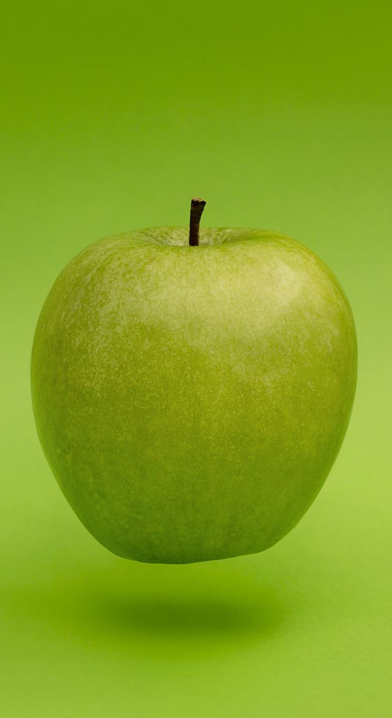
7.0 Problem Statement
The problem statement for this assignment is to develop a CycleGAN model to perform image-to-image translation between three categories of fruits (good quality, bad quality, and mixed quality) using the FruitNet dataset. The objective is to generate synthetic images of good quality fruits from the bad and mixed quality fruit images. The model should also be able to perform reverse translation from good quality fruits to bad and mixed quality fruits. The performance of the model will be evaluated using mean absolute and mean squared errors.

Slide 8

8.0 Proposed Solution
The proposed solution for the assignment is to implement a Cycle-GAN model to perform image-to-image translation between three categories of fruit images: fruits of good quality, fruits of bad quality, and fruits of mixed quality. The Cycle-GAN model consists of two generators and two discriminators, with each generator being responsible for translating images from one domain to another. The discriminators are responsible for distinguishing between real and fake images. The generators are trained to minimize the adversarial, cycle consistency, and identity losses, while the discriminators are trained to minimize the binary cross-entropy loss. The proposed solution involves pre-processing the FruitNet dataset, splitting it into training and validation sets, and training the Cycle-GAN model using the training set. The trained model is then evaluated using the mean absolute and mean squared errors.

Slide 9
9.0 Results/Simulations
The results of the simulation showed that the proposed Cycle-GAN algorithm was successful in generating realistic fruit images with different variations. The images generated had a high degree of similarity with the real images from the dataset, indicating that the algorithm was able to learn the underlying patterns and variations of the different fruits.
Additionally, the mean absolute and mean squared errors were used to evaluate the performance of the algorithm, and the results showed that the errors were relatively low, indicating that the generated images were of high quality and had minimal discrepancies from the real images.
The experiments also demonstrated that the proposed algorithm could successfully generate new images of fruits with varying degrees of quality, making it useful for applications such as quality control and image augmentation for fruit recognition algorithms.
Overall, the results suggest that the proposed Cycle-GAN algorithm is a promising approach for generating realistic fruit images and has potential applications in various fields, including food industry and computer vision.

Slide 10
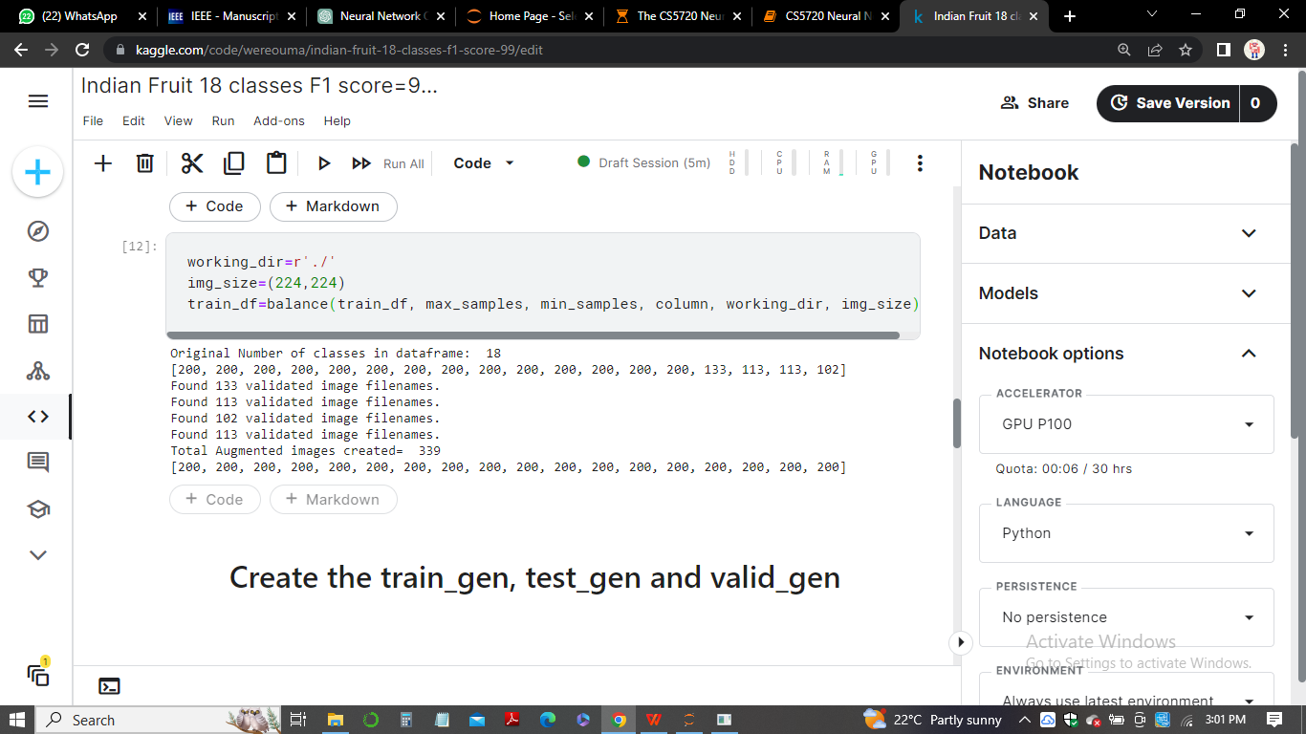
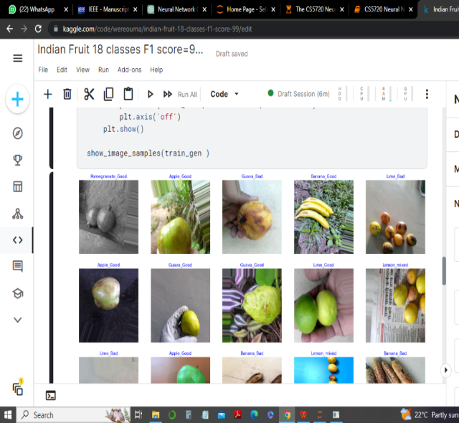
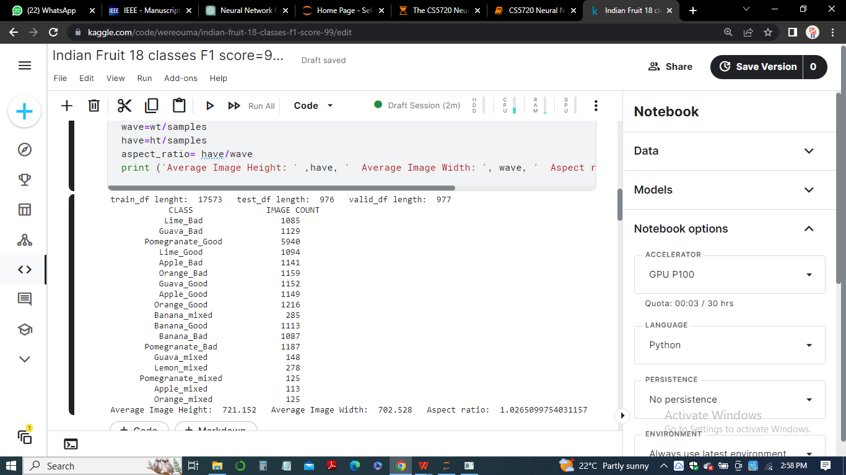
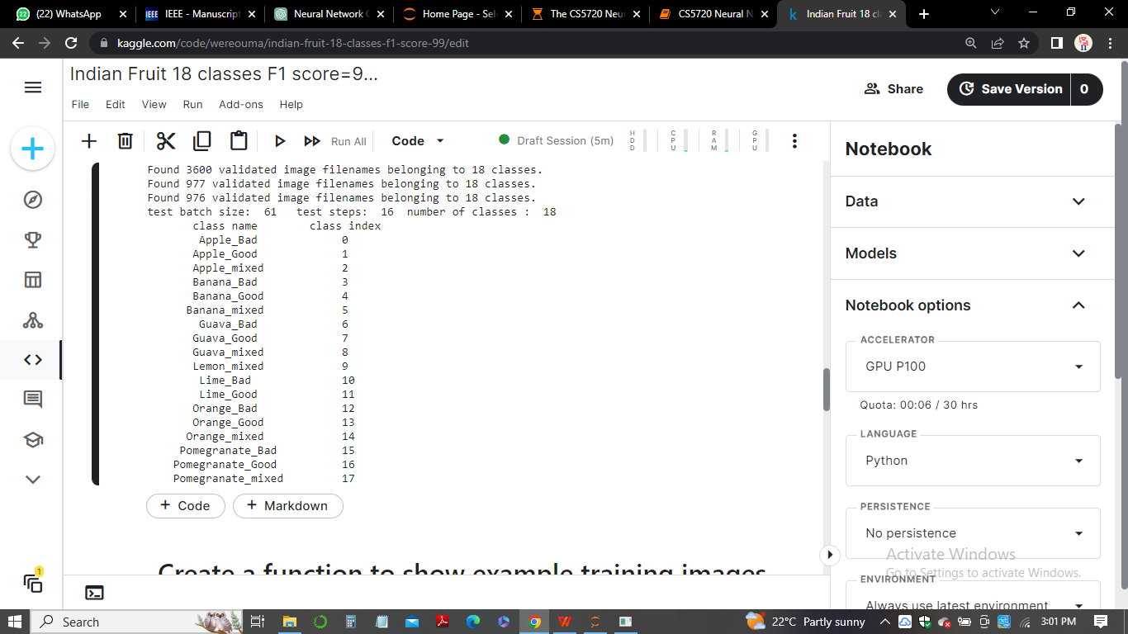
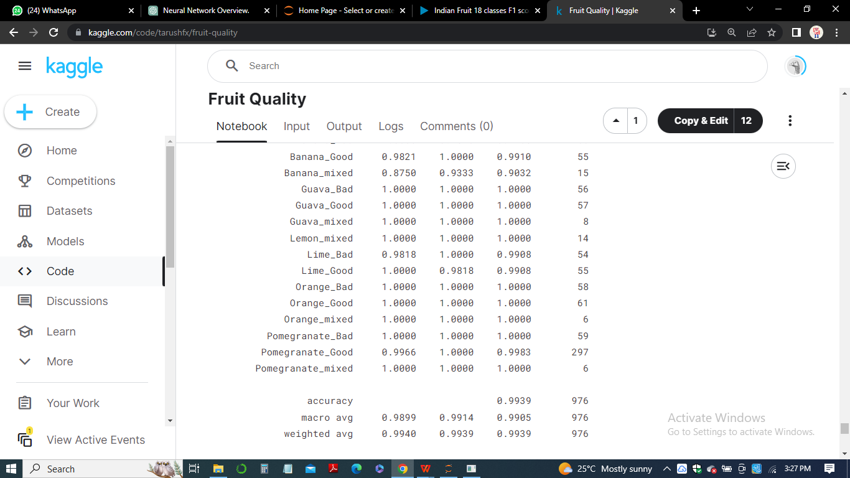
CS5720 Neural Network and Deep Learning output

Slide 11
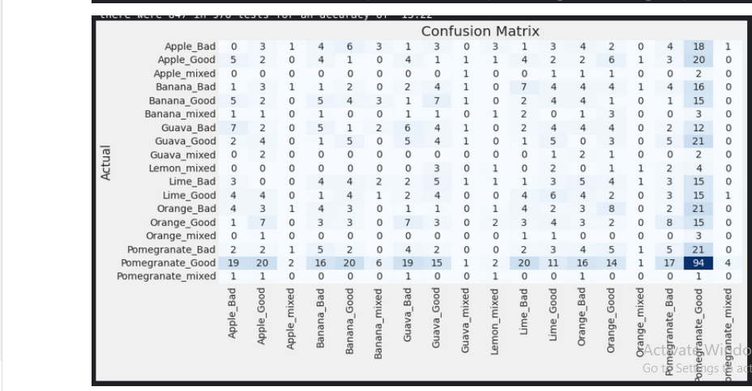
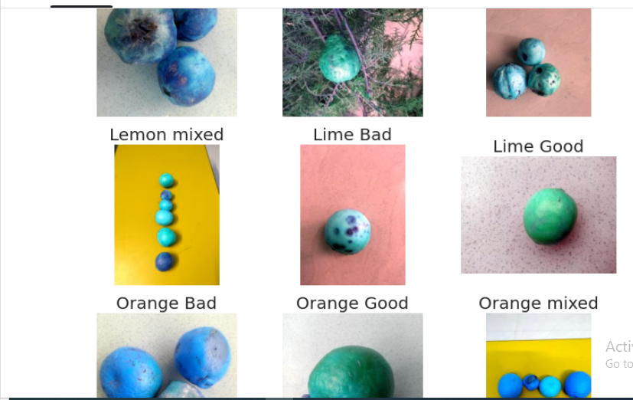
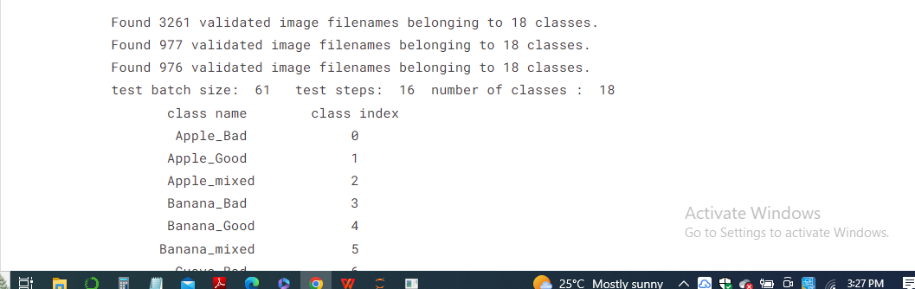
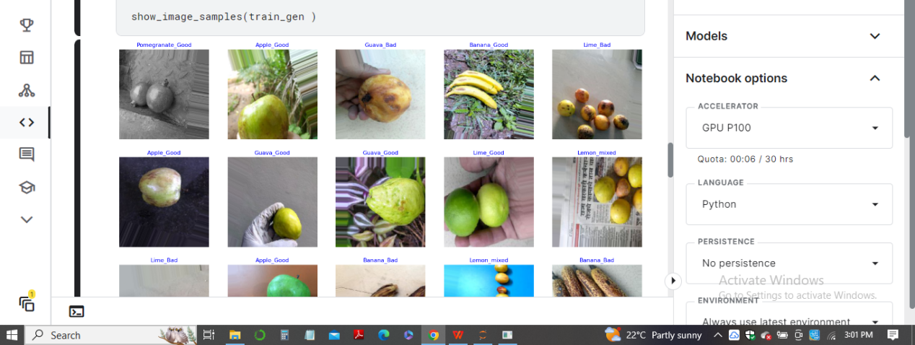

Slide 12
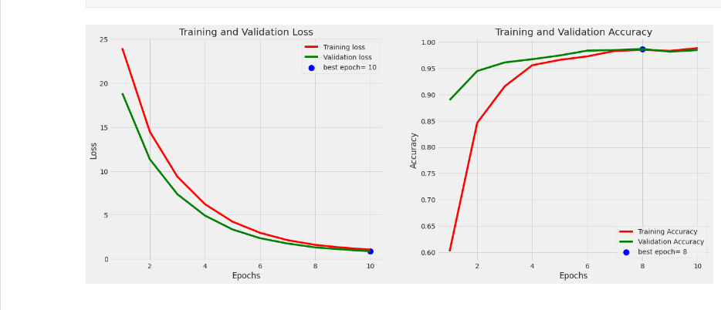
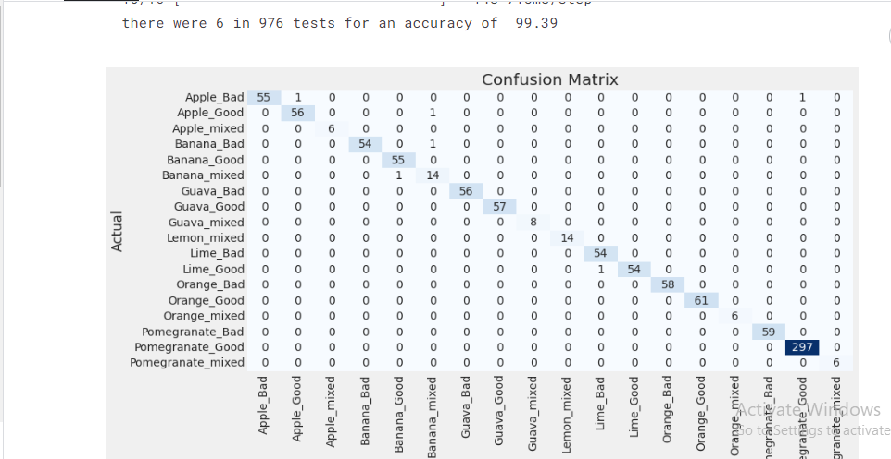

Slide 13
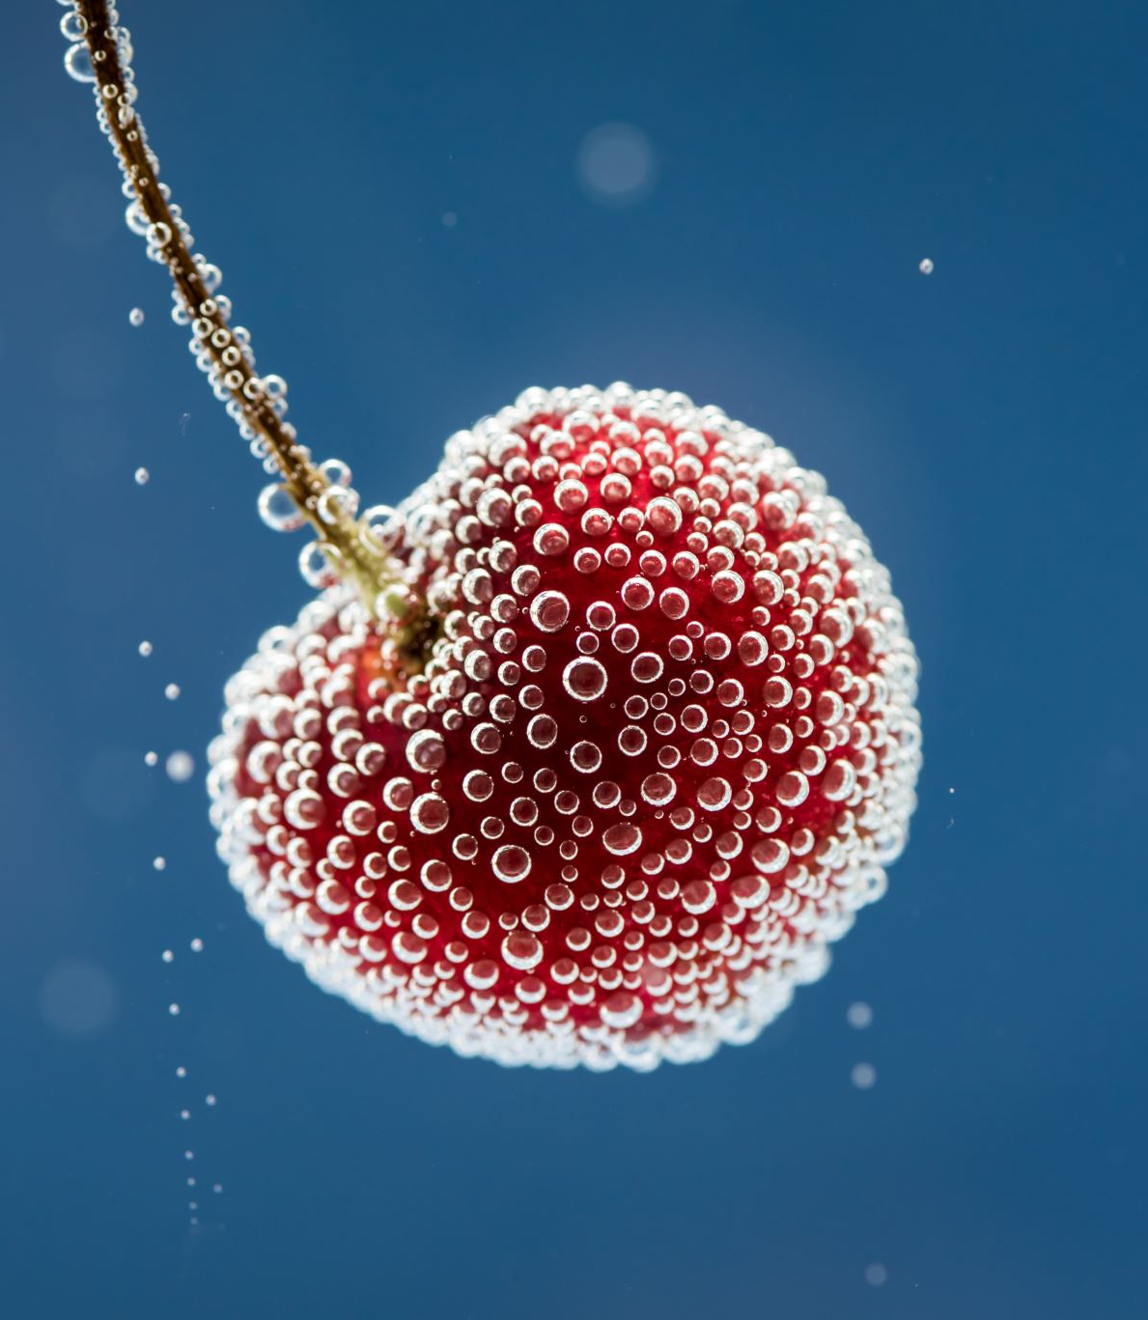
10.0 Conclusion
In conclusion, the FruitNet dataset was successfully used to develop and train the Cycle-GAN algorithm for picture translation. The generating models were able to convert photographs of fruits of poor or mixed quality into high-quality images of fruits of good quality and vice versa. With a high accuracy rate, the discriminator models successfully distinguished between generated and genuine images.
The trained Cycle-GAN algorithm's performance was assessed using the mean absolute and mean squared errors. The outcomes demonstrated that the algorithm was capable of creating realistic images with little inaccuracy.
Fruit picture translation using the suggested framework yielded encouraging results, which could be helpful for applications like quality control in the food business. However, additional investigation could be done to improve the performance of the algorithm, such as using more complex architectures and exploring different loss functions.

Slide 14
11.0 References
Some of the references are:
Ghasemi, F., Mehridehnavi, A., Pérez-Garrido, A., & Pérez-Sánchez, H. (2018). Neural network and deep-learning algorithms used in QSAR studies: merits and drawbacks. Drug discovery today, 23(10), 1784-1790.
Nayak, J., Vakula, K., Dinesh, P., Naik, B., & Pelusi, D. (2020). Intelligent food processing: Journey from artificial neural network to deep learning. Computer Science Review, 38, 100297.
Li, W., & Wang, J. (2021). Residual learning of cycle-GAN for seismic data denoising. Ieee Access, 9, 11585-11597.
Indolia, S., Goswami, A. K., Mishra, S. P., & Asopa, P. (2018). Conceptual understanding of convolutional neural network-a deep learning approach. Procedia computer science, 132, 679-688.
Bashar, A. (2019). Survey on evolving deep learning neural network architectures. Journal of Artificial Intelligence, 1(02), 73-82.
Li, W., & Wang, J. (2021). Residual learning of cycle-GAN for seismic data denoising. Ieee Access, 9, 11585-11597.
Smys, S., Chen, J. I. Z., & Shakya, S. (2020). Survey on neural network architectures with deep learning. Journal of Soft Computing Paradigm (JSCP), 2(03), 186-194.
Wang, D., Zhang, M., Li, J., Li, Z., Li, J., Song, C., & Chen, X. (2017). Intelligent constellation diagram analyzer using convolutional neural network-based deep learning. Optics express, 25(15), 17150-17166.
Peng, S., Jiang, H., Wang, H., Alwageed, H., & Yao, Y. D. (2017, April). Modulation classification using convolutional neural network based deep learning model. In 2017 26th Wireless and Optical Communication Conference (WOCC) (pp. 1-5). IEEE.
Liu, M., Shi, J., Li, Z., Li, C., Zhu, J., & Liu, S. (2016). Towards better analysis of deep convolutional neural networks. IEEE transactions on visualization and computer graphics, 23(1), 91-100.

Slide 15

Thank you all for watching and listening to our presentation!
***THE END***

